Slide 1
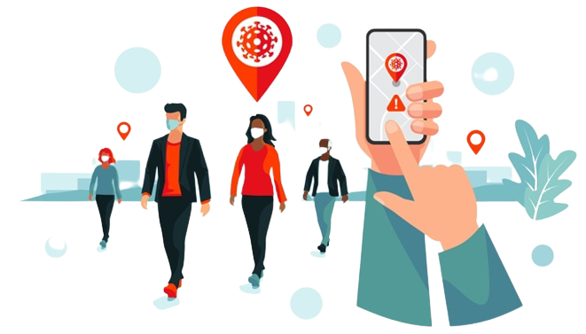
CONTACT
TRACING
APPLICATION
GROUP 11
E/17/005 - M.I.Rishard
E/17/379 - S.P.D.D.S.Weerasinghe
E/17/327 - A.M.F.Shalha

Slide 2
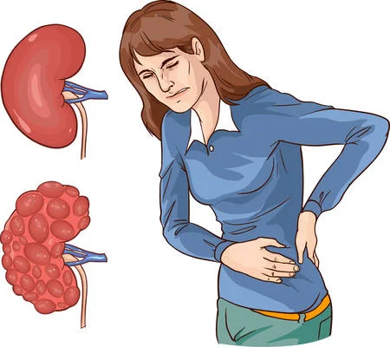
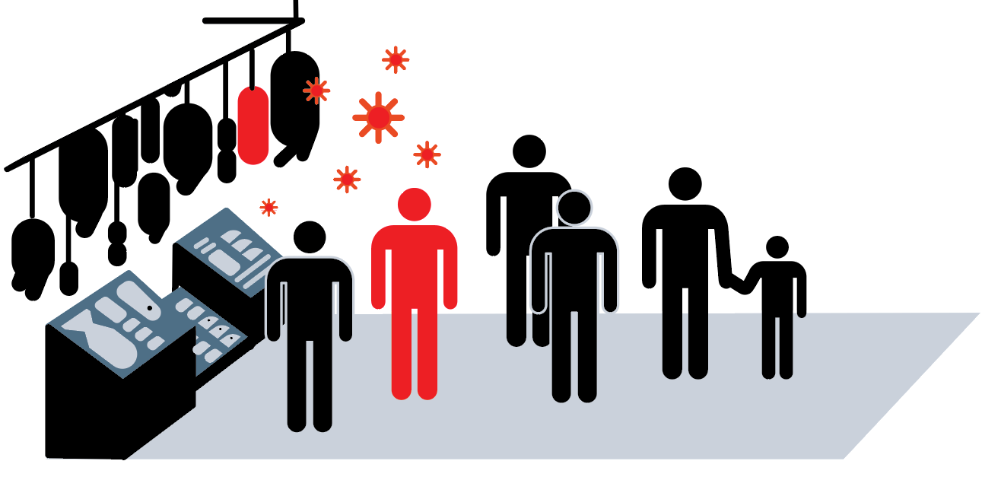
PROBLEM DIAGNOSIS

Slide 3


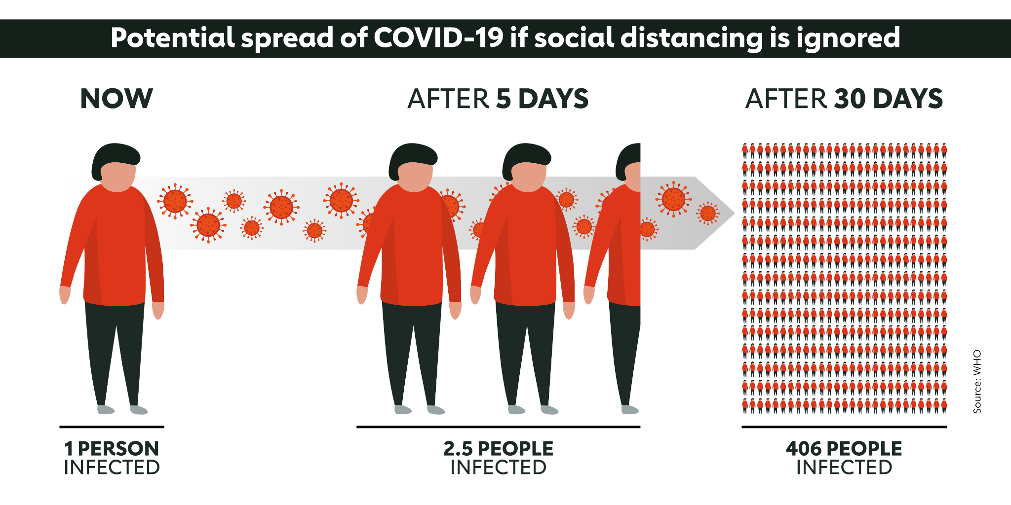
COVID-19 ( Communicable )
Inefficiency to trace the close contacts of an infected person manually.
Not being able to know whether you've been in contact with an infected person.
Lack of options to know whether a public place was visited by an infected person recently.
name -
address -

Slide 4
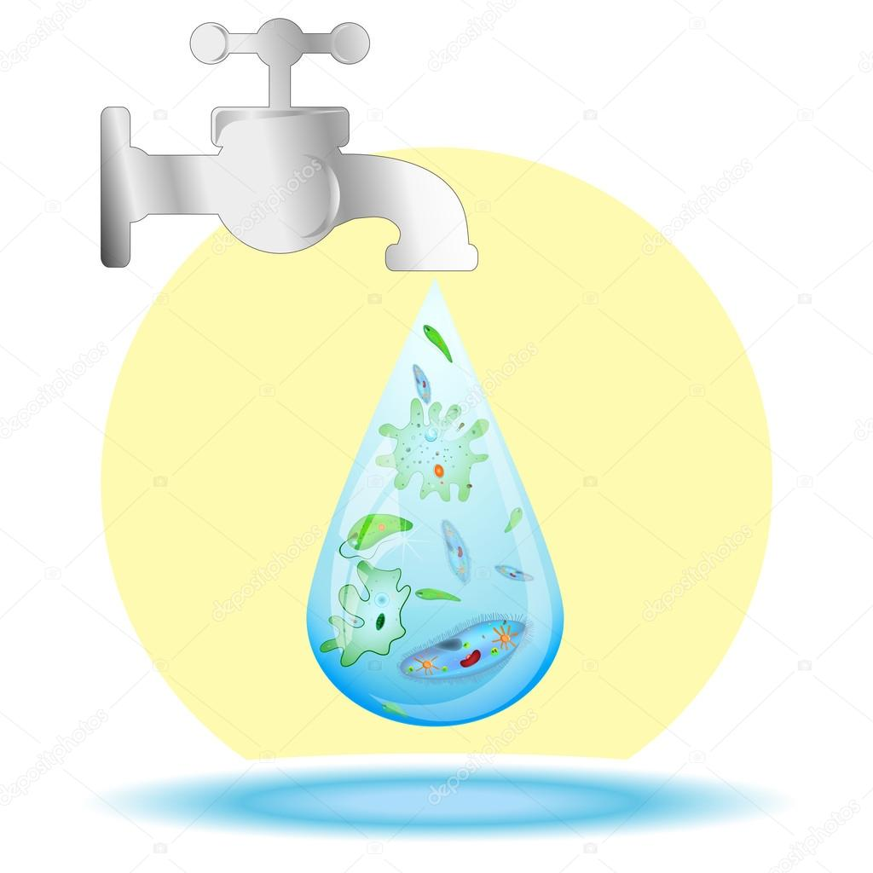
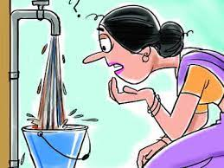
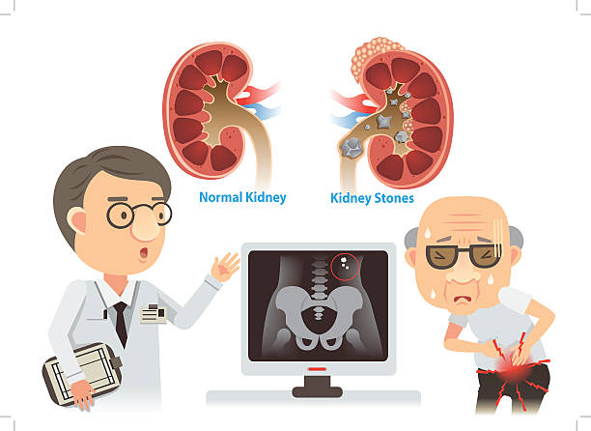

Chronic Kidney Disease/CKDu ( Non-Communicable)
Lack of awareness
Difficulty in manually sorting data to identify the spreading rates and trends.
No efficient way to identify disease spreading hotspots/areas by the general public .

Slide 5
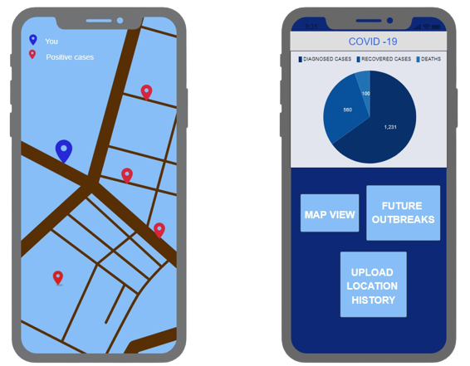
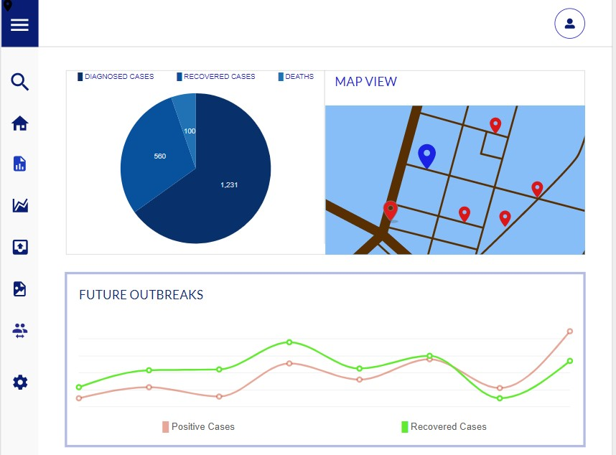
SOLUTION FOR
COMMUNICABLE DISEASES
( COVID 19 )

Slide 6
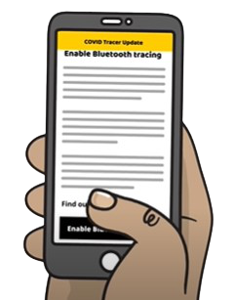
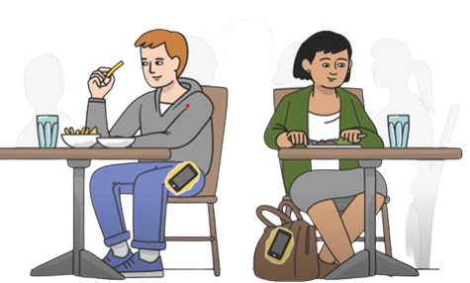
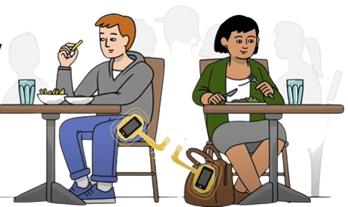
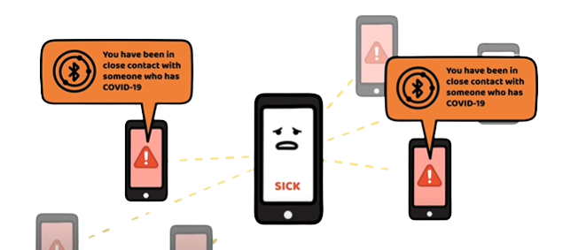
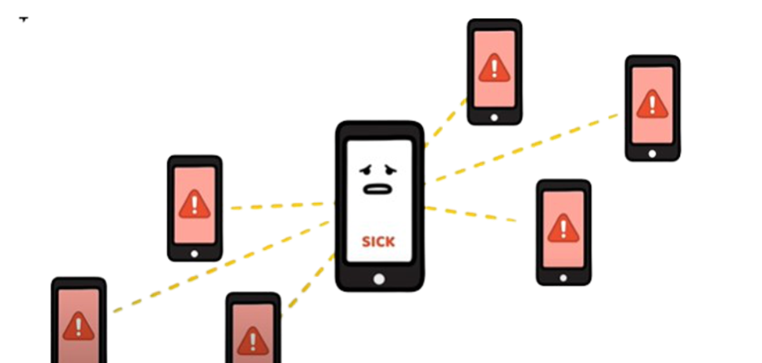
1.Bluetooth permission enabled
2.When user comes into close proximity with another user
3.Both the phones nearby anonymously digitally hi fives each other
5. If any close contact is detected they will be alerted
4.Once infected person updates his status all the others will be cross checked

Slide 7
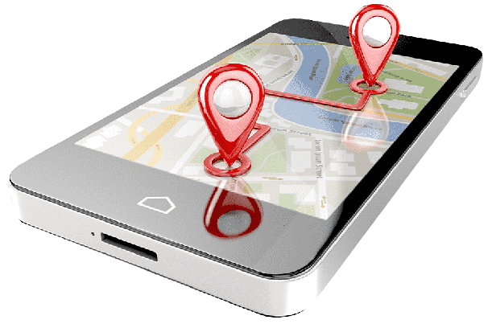
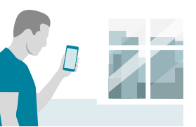
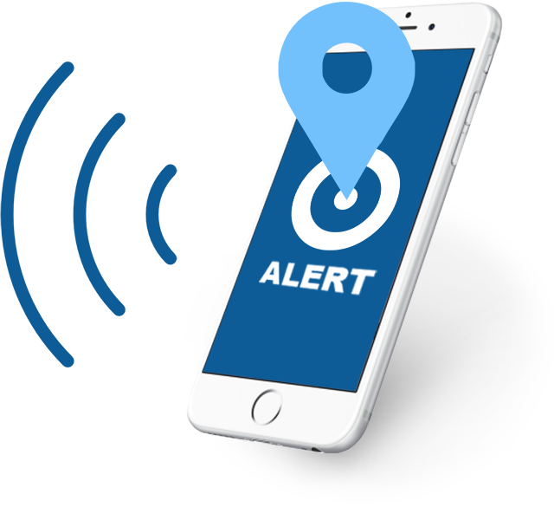
GPS tracks the whereabouts and saves them in a private database anonymously.
2. infected users updates their status to public database anonymously.
3. based on this information
high risk hotspots are detected.
when another user enters high risk zone he is alerted
analytics and visualizations are generated
Notes:
The location of the people in contact with the infected individual is being tracked by GPS(Global Positioning System) TrackingSystem.
After the survey of all the papers it is crystal clear that GPS tracking plays a very beneficial role in this application through which we can track the location of the infected individual. The most crucial factor that is being pointed in all the papers is theprivacy of the users.

Slide 8
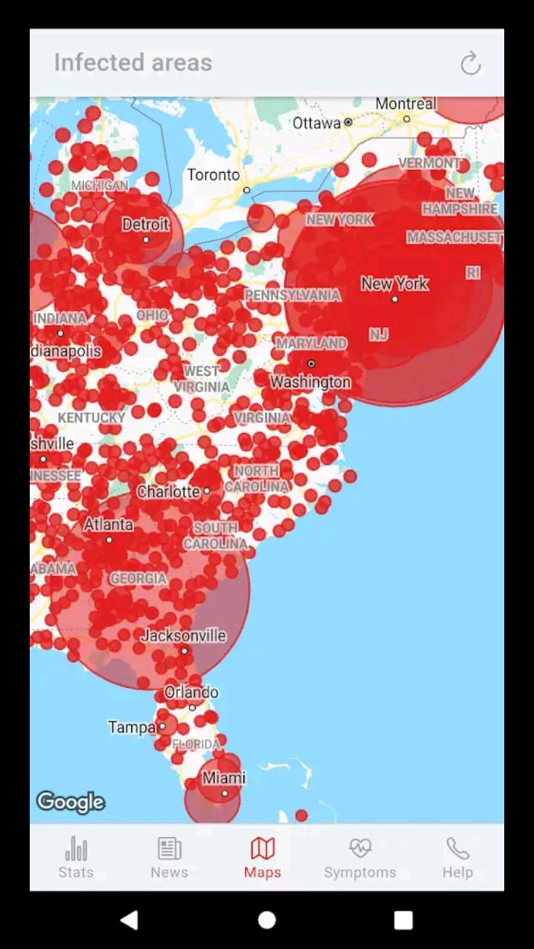
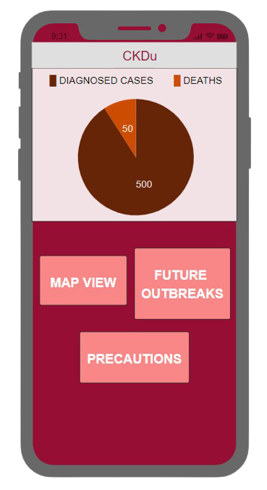
SOLUTION FOR
NON-COMMUNICABLE DISEASES
( CHRONIC KIDNEY DISEASE )

Slide 9

1.Extract Diagnosed case information
updated to public database by health
authorities.
2.Based on that , information
3. Analytics and visualizations are generated for authorities
4.Future predictions of the trend in the outbreak
1.People in high risk areas will be notified
2.General public can identify potential risks of specific areas.
Notes:
take necessary precautions
map diagramns
RELOCATE LIVING PLACE
he can be caussions of the disease and take neccesarry precautions to prevent getting diagnosed ex-use treated water for drinking
3.generate A AND v WHICH CAN BE USED BY A TO TAKE NECESARY ACTIONS REGARDING THE DESEASE
4. WHICH IS ALOS USESULL FOR A TO INFORM THE SOCITY AD TAKE NECCESRY ACCTIONS

Slide 10
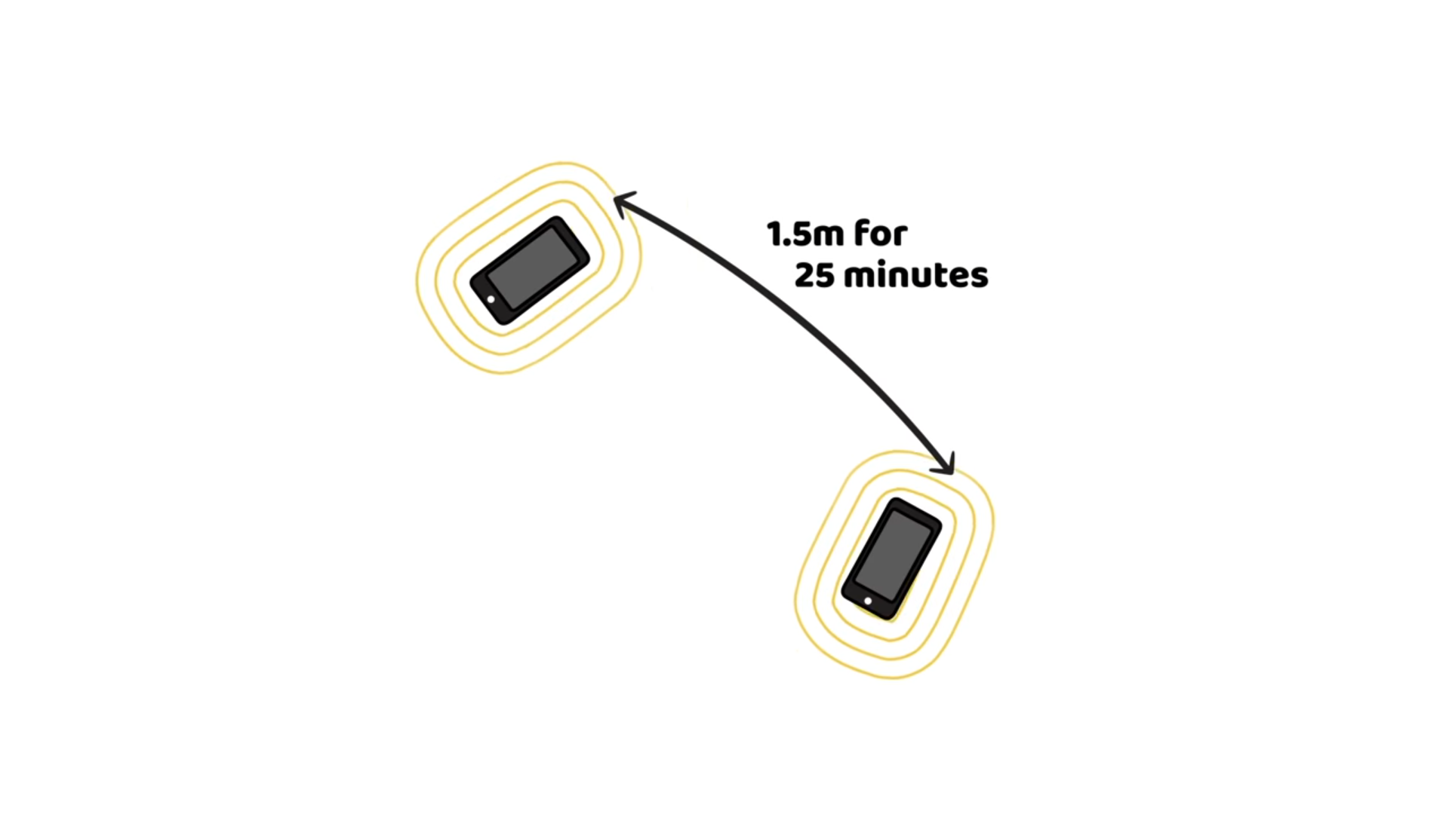
Why these Technologies are used?
Main Contact tracking technologies
1.Bluetooth tracing use
anonymous random
keys.
Privacy is protected.
Can measure time and
distance between
devices and make make
accurate predictions of
the danger level
2. GPS-derived
location data
makes it possible
to map and
analyze the spread
level of diseases
Notes:
accuracy depends on whethe they scan or not
Goverenment can identify threat levels of diseases and decide to make safety measures
BLe is accurate and quick in contact tracing and then notifying
problem in ble is deriving location data

Slide 11
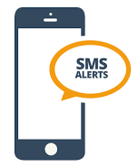
Alternative mechanism for those who do not have a smartphone or app
Use APIs for reliable SMS delivery ( Twillio )
Track relevant mobile numbers for the area
send alert messages using api

Slide 12

PLAN OF WORK

Slide 13
PHASE 1
PHASE 2
PHASE 3
PHASE 4
Research on Problem domain and solution
identification
Designing the user interface
Developing front end of web and mobile application
Developing back end of web and mobile application
PHASE 5
PHASE 6
PHASE 7
PHASE 8
Create a data set
Developing the ML model
System integration
Delivering the product
Notes:
client changes can be made.

Slide 14
Extendability
Can be extended to any other communicable and
non-communicable diseases
Ex: Typhoid
Dengue
Can add or change features according to the user requirements
Business value
government and non profitable organizations
Success Measure
introduce the product to the university students and management

Slide 15

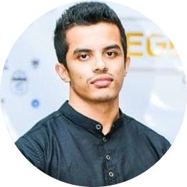
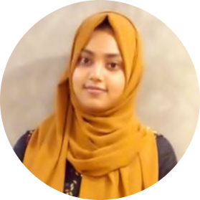
Team work
Project management skills
Communication skills
Database management
Front end development
Back end development
ML and Data Mining
OUR TEAM

Slide 16

THANK
YOU !

Slide 17

Q & A

